Slide 1




Elmhurst
Reducing 30-Day Sepsis Readmission Rates
Performance Improvement Project
S4 Severe Sepsis & Septic Shock Coordinating Team Meeting
Presented by:
Varun Putta
Intern at Quality Management,
Elmhurst Medical Center

Slide 2

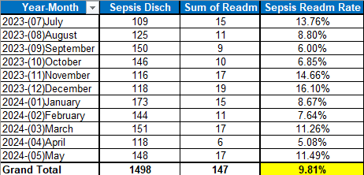
Elmhurst
Current State and Aim
Current Sepsis Readmission Rate: 9.8% (July 2023 - May 2024) - MICU
National Average: 20-25%
Top Performing Hospitals: ~15%
SMART TARGET : Reduce 30-day sepsis readmission rates by 10% in 3 months

Slide 3
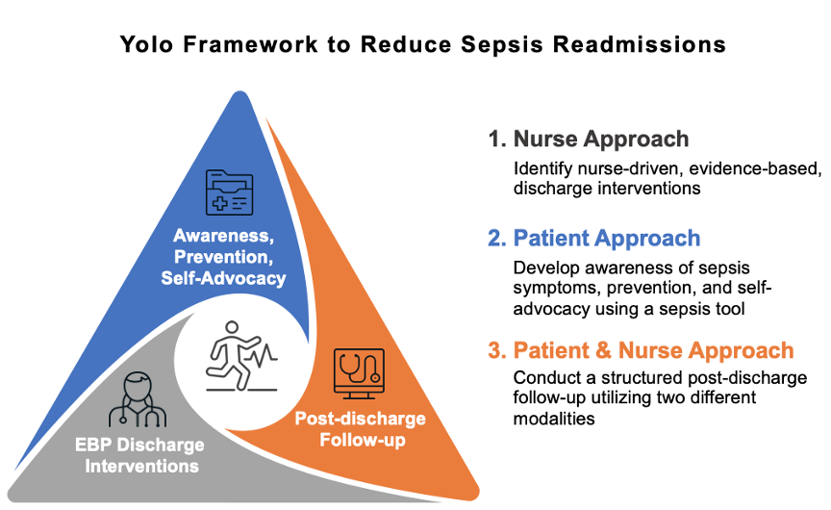
Elmhurst
s
Key Interventions
Enhanced Discharge Planning:
Standardized discharge checklist
Comprehensive discharge instructions
Scheduled follow-up appointments
Post-Discharge Follow-Up:
Follow-up phone calls within 48 hours
Telemedicine check-ins within 7 days
Home health services for high-risk patients

Slide 4
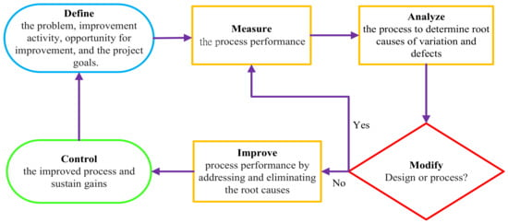
Elmhurst
Process Measure & Outcomes Measure
Process Measure: Link to Care
Ensuring all sepsis patients are linked to appropriate
follow-up care before discharge.
Actions:
Schedule follow-up appointments prior to discharge.
Coordinate care between healthcare providers.
Provide clear, detailed discharge instructions to patients
and their families.
Outcome Measure: 30- Day Readmission Rate
Reduction in 30-day sepsis readmission rates by
2 % in 3 months
Improved patient outcomes and satisfaction

Slide 5
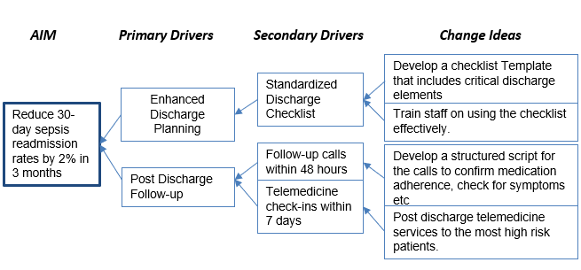
Elmhurst
Balance Measure and Equity Lens
Balance Measure: Increase in overall hours spent in call times
Implement Regular Check-ins: : Schedule periodic calls to patients
to discuss their health.
Utilize Data Tracking: Monitor call logs and patient engagement
metrics to identify trends and optimize call strategies, aiming to
increase the overall hours spent in meaningful interactions.
Equity Lens: Ensuring Equitable Access to Follow- Up Care
Analyze disparities in follow-up care access and outcomes.
Provide resources such as language assistance, transportation,
and financial support.
Notes:
introduces our balance measure and equity lens for ensuring effective and equitable follow-up care. Our balance measure focuses on monitoring the 'Show Rate for Follow-Up Appointments,' which tracks the percentage of patients attending their scheduled appointments. To enhance attendance, we implement reminders via phone, email, or text, and offer support for transportation or other barriers that patients may face.
Simultaneously, our equity lens emphasizes the importance of ensuring equitable access to follow-up care. We analyze disparities in access and outcomes among different patient demographics. By providing resources such as language assistance, transportation options, and financial support, we aim to mitigate barriers and ensure that all patients receive the necessary follow-up care, regardless of their circumstances."

Slide 6
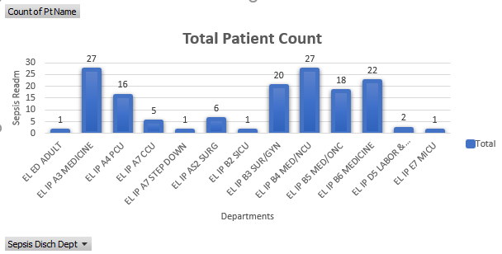
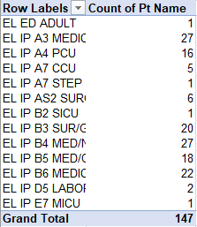
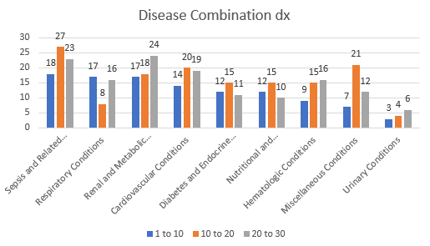
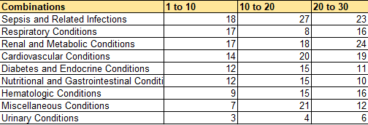
Elmhurst
Notes:
introduces our balance measure and equity lens for ensuring effective and equitable follow-up care. Our balance measure focuses on monitoring the 'Show Rate for Follow-Up Appointments,' which tracks the percentage of patients attending their scheduled appointments. To enhance attendance, we implement reminders via phone, email, or text, and offer support for transportation or other barriers that patients may face.
Simultaneously, our equity lens emphasizes the importance of ensuring equitable access to follow-up care. We analyze disparities in access and outcomes among different patient demographics. By providing resources such as language assistance, transportation options, and financial support, we aim to mitigate barriers and ensure that all patients receive the necessary follow-up care, regardless of their circumstances."

Slide 7
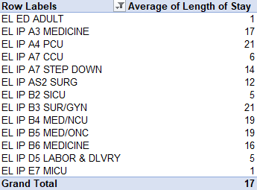
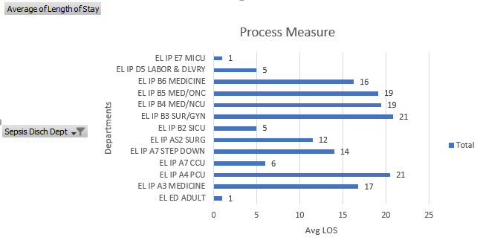
Elmhurst
Length of stay (LOS) as a Process Measure
Overall Average LOS: Approximately 17.4 days per admission across all units.
Units with Highest LOS:
B3 SUR/GYN: 20.9 days/admission
A4 PCU: 20.5 days/admission
B4 MED/NCU: 19.5 days/admission
Units with Lowest LOS (single cases):
A7 STEP DOWN: 14 days/admission
B2 SICU: 5 days/admission
Variation: Significant differences in LOS among units indicate potential areas for quality improvement, especially in high LOS units.
Notes:
introduces our balance measure and equity lens for ensuring effective and equitable follow-up care. Our balance measure focuses on monitoring the 'Show Rate for Follow-Up Appointments,' which tracks the percentage of patients attending their scheduled appointments. To enhance attendance, we implement reminders via phone, email, or text, and offer support for transportation or other barriers that patients may face.
Simultaneously, our equity lens emphasizes the importance of ensuring equitable access to follow-up care. We analyze disparities in access and outcomes among different patient demographics. By providing resources such as language assistance, transportation options, and financial support, we aim to mitigate barriers and ensure that all patients receive the necessary follow-up care, regardless of their circumstances."

Slide 8
Elmhurst
Outcome Measure : Sepsis Readmission Rates

Slide 9
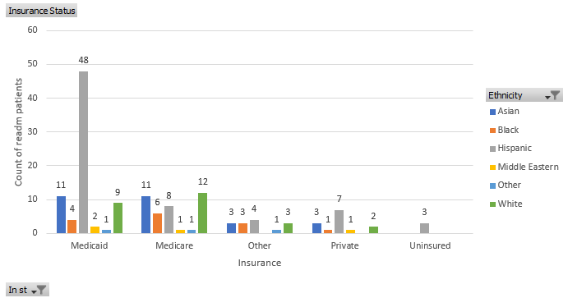
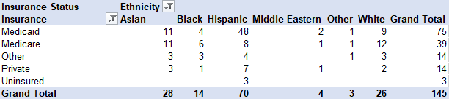
Elmhurst
Equity Lens
Medicaid's Key Role: The majority of patients (76) are on Medicaid, especially Hispanic patients (48), highlighting its importance in providing access to care for this group.
Medicare Distribution: Medicare serves fewer patients (39), with a higher representation of White patients (12) compared to Hispanic (8) and Black (6), suggesting potential disparities in access.
Private Insurance Gaps: Only 14 patients have private insurance, predominantly Hispanic (7). This indicates barriers to obtaining private coverage, particularly for this demographic.
Uninsured Risk: There are 3 uninsured patients, all Hispanic, pointing to significant access issues that need addressing.
Hispanic Population Impact: The Hispanic group comprises a substantial portion (70) of the total (146), underscoring the need for targeted resources and culturally competent care.

